Slide 1

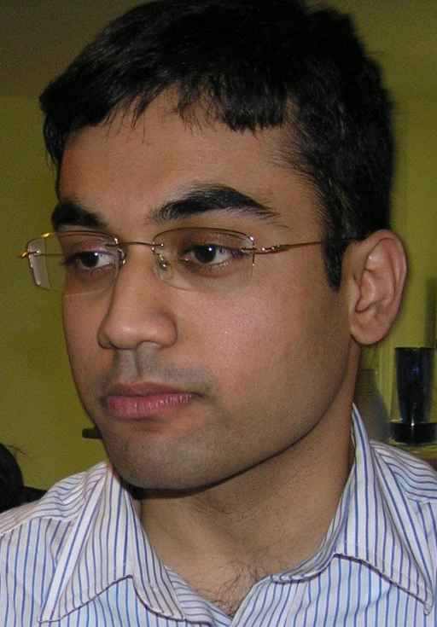






Self-Supervised Learning by Cross-Modal Audio-Video Clustering
Humam Alwassel¹
Dhruv Mahajan²
Bruno Korbar²
Lorenzo Torresani²
Bernard Ghanem¹
Du Tran²
¹
²

Slide 2
[THE PROBLEM] annotating videos is expensive and time-consuming
[ONE SOLUTION] find ways to use “free” annotations from the data itself (self-supervision)

Slide 3
But can self-supervised video pretraining outperform fully-supervised pretraining?

Slide 4
But can self-supervised video pretraining outperform fully-supervised pretraining?
Yes!
Our method is the first to demonstrate such performance
→We propose a self-supervised task that exploits the strong correlation between video and audio

Slide 5
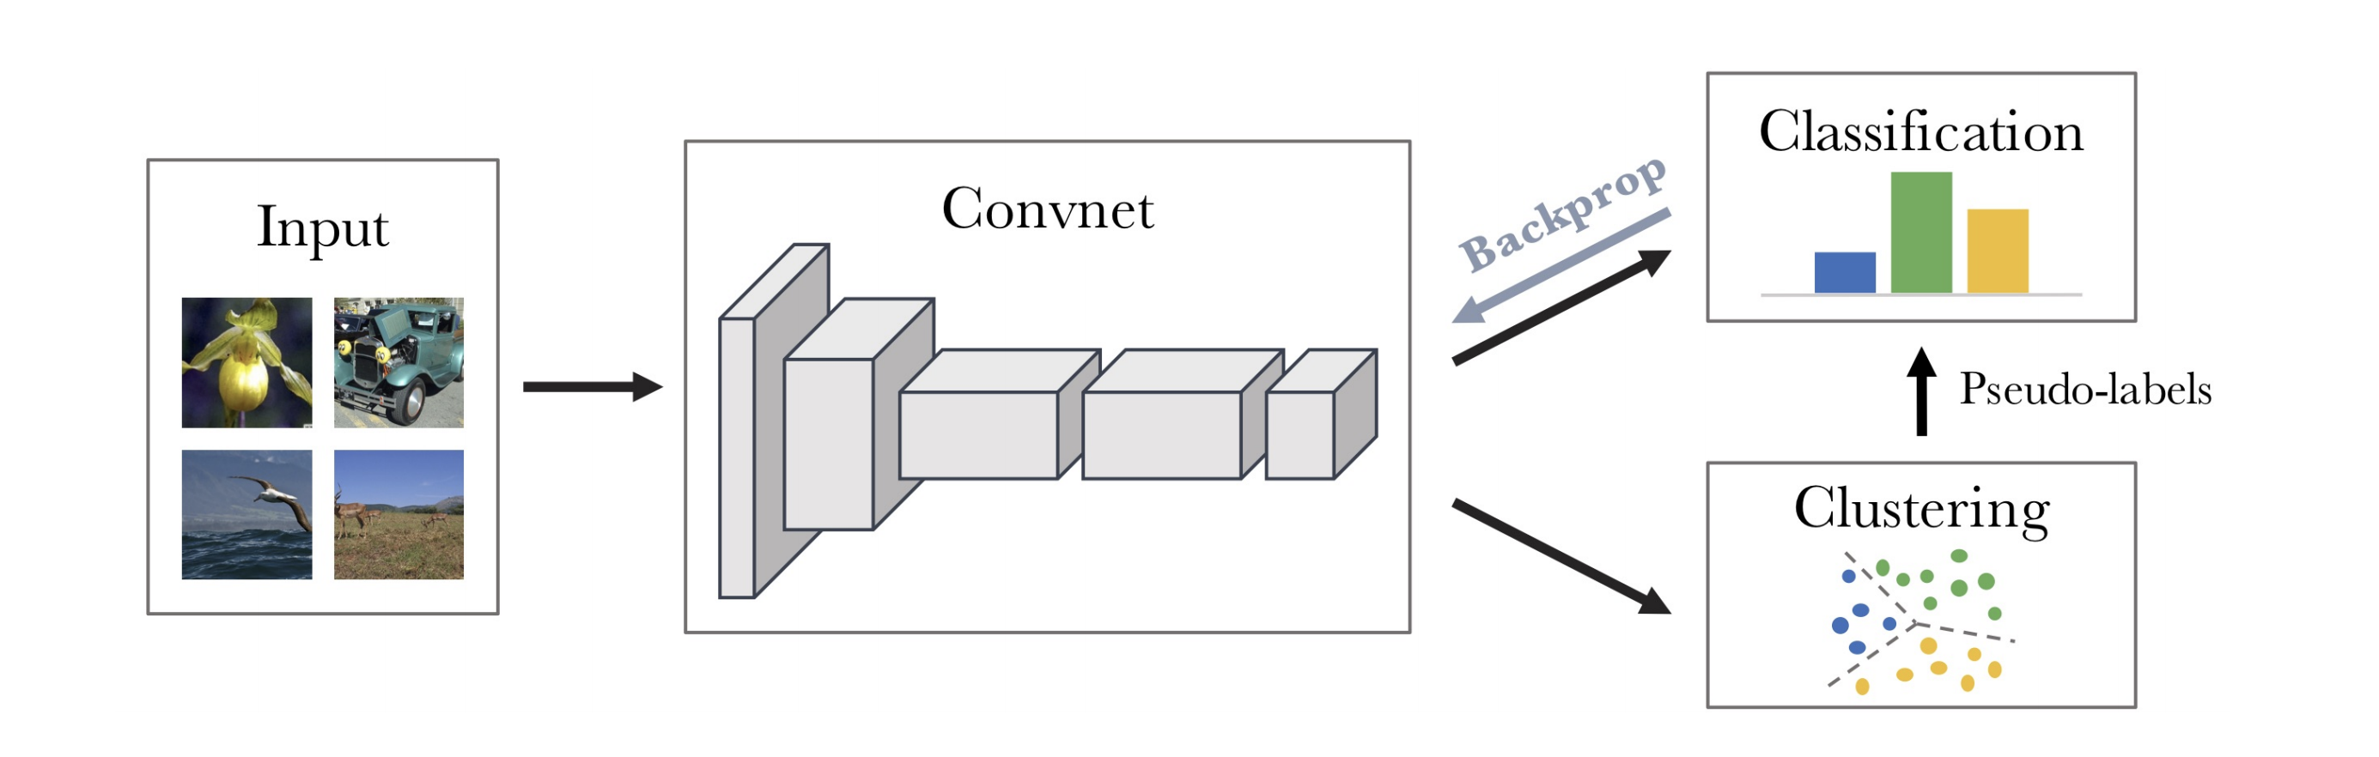
Related work: single-modality deep clustering
Caron, et al. Deep Clustering for Unsupervised Learning of Visual Features. ECCV 2018

Slide 6
We Propose Cross-Modal Deep Clustering

Slide 7
We Propose Cross-Modal Deep Clustering

Slide 8
We Propose Cross-Modal Deep Clustering

Slide 9
We Propose Cross-Modal Deep Clustering

Slide 10
We Propose Cross-Modal Deep Clustering

Slide 11
We Propose Cross-Modal Deep Clustering

Slide 12
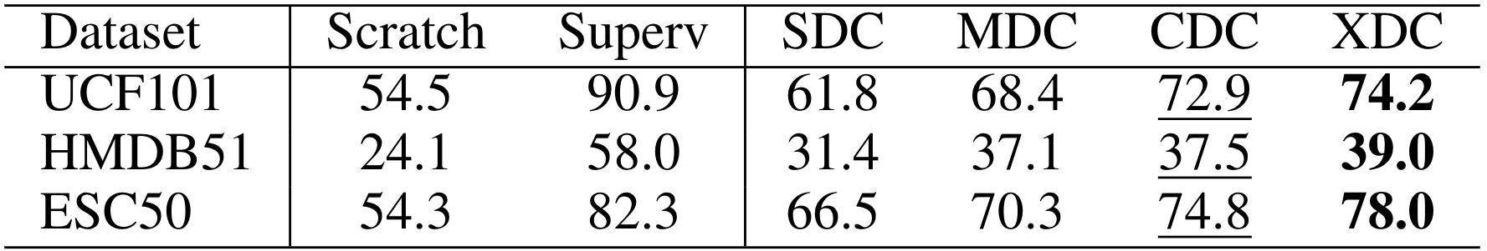
Single-Modality vs. Multi-Modality Deep Clustering
Self-supervised pretrain on Kinetics
Full-finetune on HMDB51, UCF101, and ESC50 (Split 1)
Baselines:
training from scratch
fully-supervised pretraining on Kinetics (Superv)

Slide 13
Single-Modality vs. Multi-Modality Deep Clustering
Self-supervised pretrain on Kinetics
Full-finetune on HMDB51, UCF101, and ESC50 (Split 1)
Baselines:
training from scratch
fully-supervised pretraining on Kinetics (Superv)

Slide 14
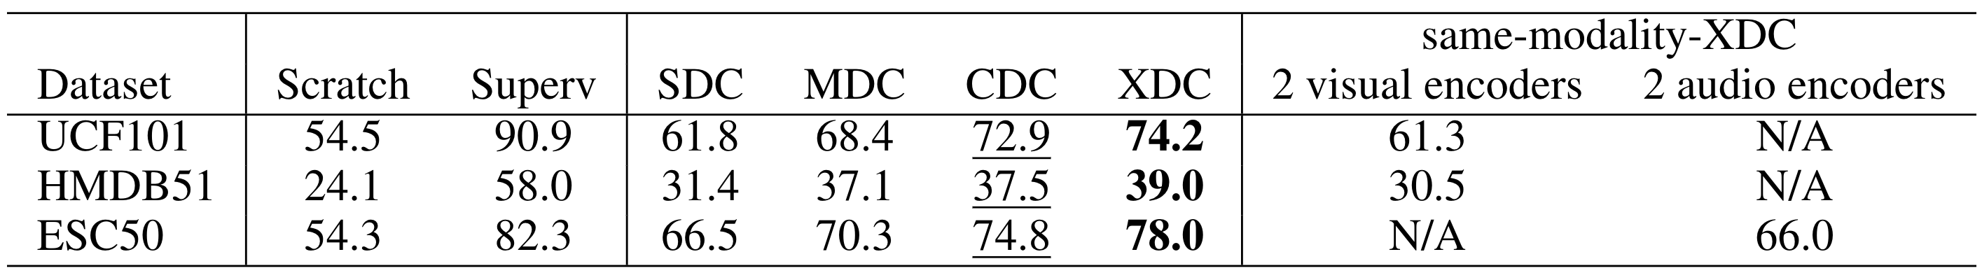
Single-Modality vs. Multi-Modality Deep Clustering
We compare with a set of baselines, called same-modality-XDC, where XDC is trained with two encoders defined on the same modality (either visual or audio).

Slide 15
Single-Modality vs. Multi-Modality Deep Clustering
We compare with a set of baselines, called same-modality-XDC, where XDC is trained with two encoders defined on the same modality (either visual or audio).

Slide 16
Pretraining Data Type and Size
XDC pretrained on five datasets vs. fully-supervised pretrained baselines (superv)
Kinetics (240K videos)
AudioSet (2M videos)
AudioSet-240K (240K videos)
IG-Kinetics (65M videos)
IG-Random (65M videos) – uncurated dataset

Slide 17
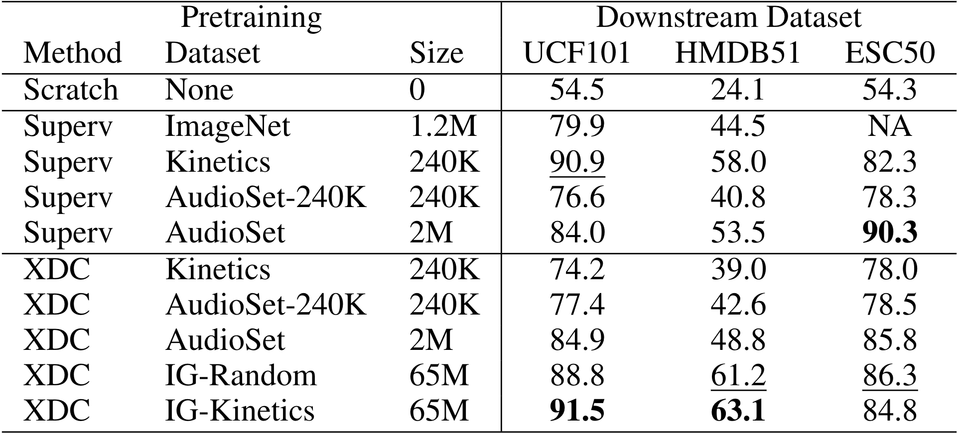
Pretraining Data Type and Size
XDC pretrained on five datasets vs. fully-supervised pretrained baselines (superv)
Kinetics, AudioSet, AudioSet-240K , IG-Kinetics, and IG-Random

Slide 18
Pretraining Data Type and Size
XDC pretrained on five datasets vs. fully-supervised pretrained baselines (superv)
Kinetics, AudioSet, AudioSet-240K , IG-Random, and IG-Kinetics

Slide 19
Pretraining Data Type and Size
XDC pretrained on five datasets vs. fully-supervised pretrained baselines (superv)
Kinetics, AudioSet, AudioSet-240K , IG-Random, and IG-Kinetics

Slide 20
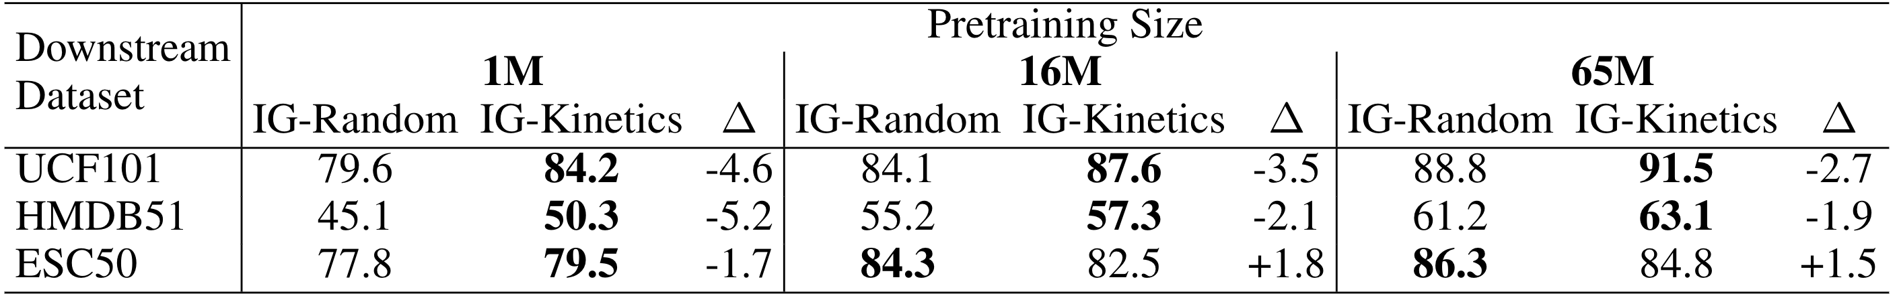
Curated vs. Uncurated Pretraining Data
XDC pretrained on IG-Kinetics (curated) vs. IG-Random (uncurated) using different pretraining sizes (1M, 16M, and 65M)

Slide 21
Curated vs. Uncurated Pretraining Data
XDC pretrained on IG-Kinetics (curated) vs. IG-Random (uncurated) using different pretraining sizes (1M, 16M, and 65M)

Slide 22
Curated vs. Uncurated Pretraining Data
XDC pretrained on IG-Kinetics (curated) vs. IG-Random (uncurated) using different pretraining sizes (1M, 16M, and 65M)

Slide 23
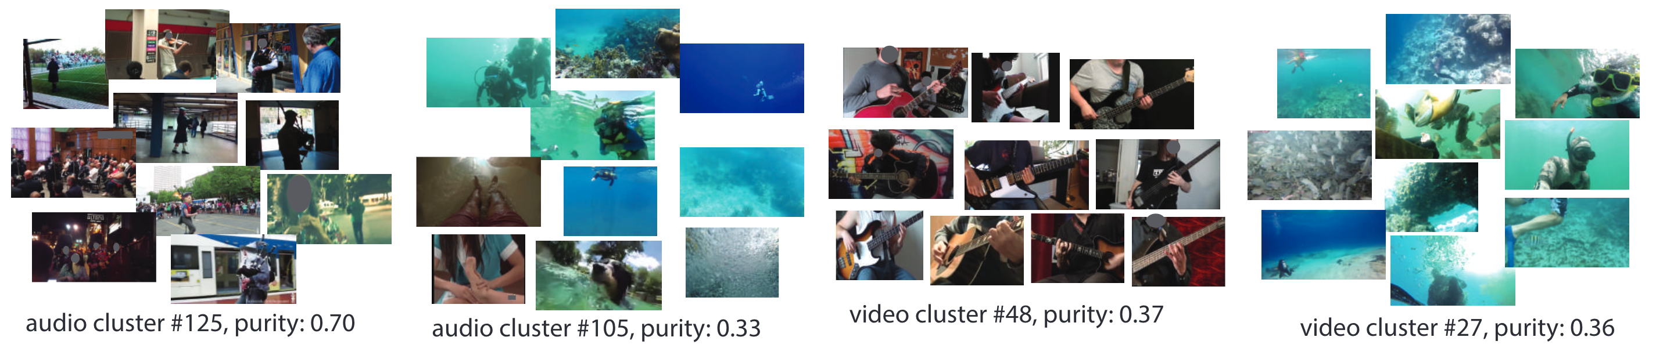
Understanding XDC
Visualization of XDC clusters on Kinetics videos

Slide 24
Understanding XDC
Visualization of XDC clusters on Kinetics videos
“playing bagpipes”

Slide 25
Understanding XDC
Visualization of XDC clusters on Kinetics videos
“play bass guitar”, “play guitar”, “tap guitar”

Slide 26
Understanding XDC
Visualization of XDC clusters on Kinetics videos
“scuba diving” with “snorkeling”
“scuba diving” with “feeding fish”

Slide 27
Understanding XDC
Visualization of XDC clusters on Kinetics videos
Please refer to our project website http://humamalwassel.com/publication/xdc/ for an interactive visualization of all XDC audio and video clusters

Slide 28
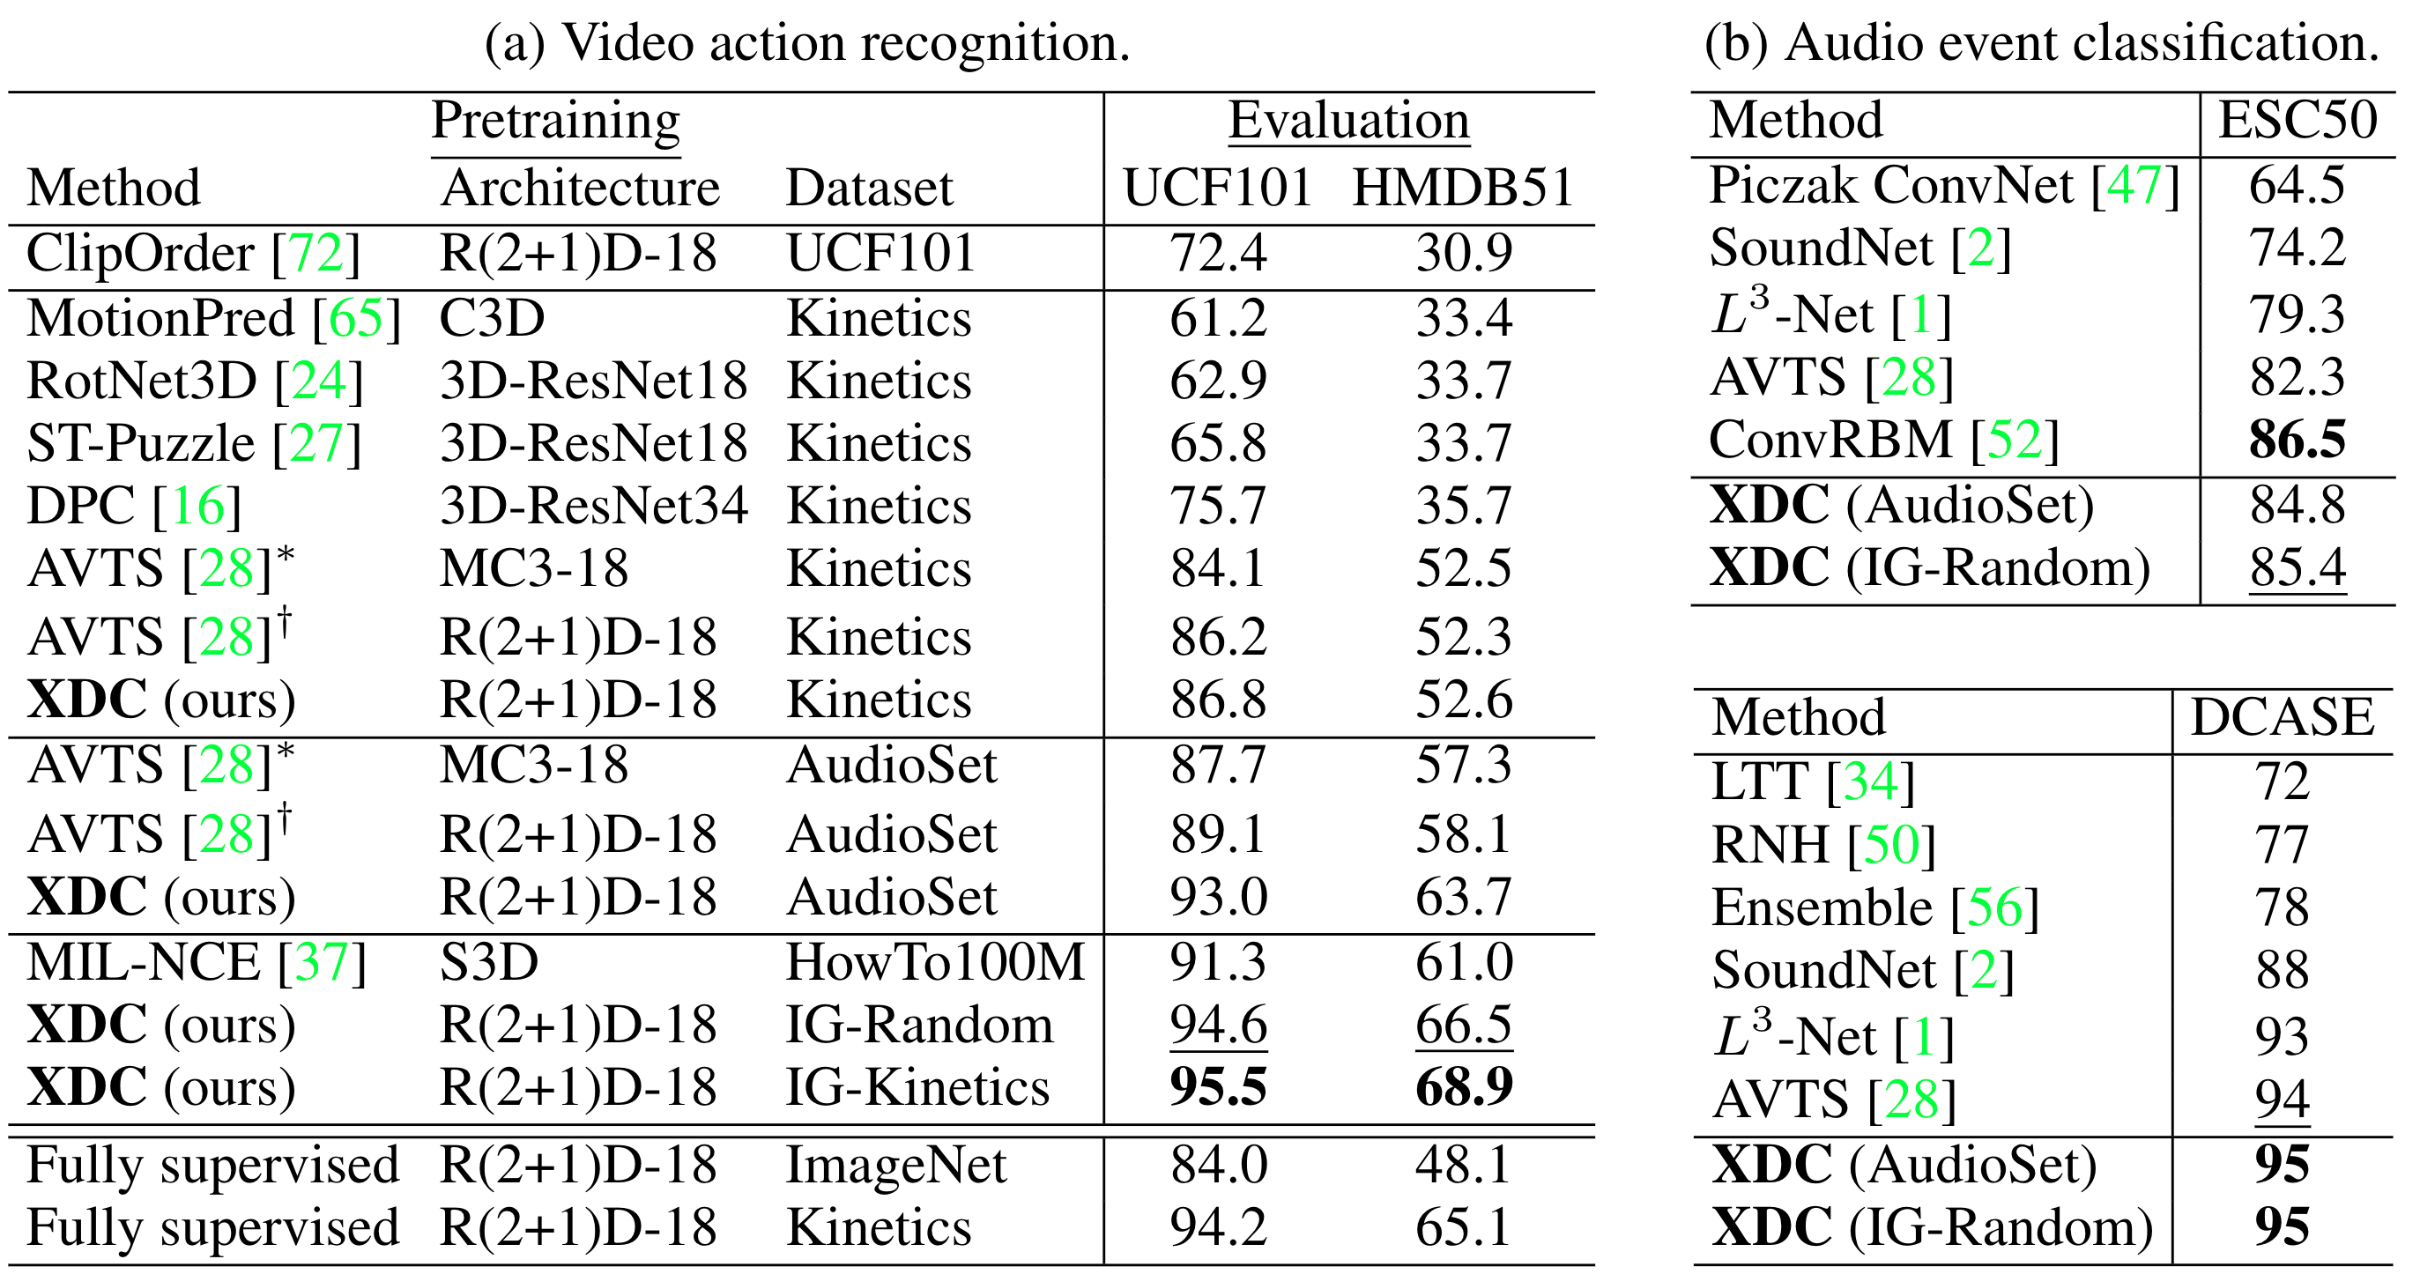
State-of-the-Art Comparison
Comparison on HMDB51, UCF101, ESC50, and DCASE (average over all splits)

Slide 29
State-of-the-Art Comparison
Comparison on HMDB51, UCF101, ESC50, and DCASE (average over all splits)

Slide 30
State-of-the-Art Comparison
Comparison on HMDB51, UCF101, ESC50, and DCASE (average over all splits)

Slide 31
State-of-the-Art Comparison
Comparison on HMDB51, UCF101, ESC50, and DCASE (average over all splits)

Slide 32
Self-Supervised Learning by Cross-Modal Audio-Video Clustering
Project website: http://humamalwassel.com/publication/xdc/

